Slide 1

BlaBlaClust
Iteratively organise a text dataset into clusters
by conversing with an AI. No ground truth: you are the oracle.
Dave · Matteo · Thomas · Nilo · Arianna
VIBE-CODERS
FINAL PROJECT PRESENTATION · JUNE 2026
Notes:
ingrandisci
‹#›

Slide 2
01 — THE PROBLEM
Research question
Can free-form natural language feedback guide a clustering system toward oracle-accepted outcomes when no ground truth exists?
A build-heavy project
with experiments designed around questions raised by related work
BlaBlaClust
2 / 17
Notes:
usiamo gmm non k means. “cosa potremmo voler fare”. meno importanza a sto esempio
‹#›

Slide 3
02 — THE SOLUTION
Core Engine - Turn Pipeline
The user describes in words what’s off — the system understands and acts.
EXECUTOR
f_apply_operations
snapshot
committed
Oracle
Input
EXECUTOR
f_output
REPAIR
f_boundary_repair
dispatches each op to the clustering engine
raw natural language from the human
(or LLM oracle)
LLM classifies intent → emits structured JSON operations (merge / split / rename / move / semantic_reembed / cluster_reembed)
inspects 10% (cap at 30) of the most uncertain boundary points of affected clusters and corrects obvious misplacements
PLANNER
f_next_best_step
SENSOR
f_cluster_uncertainty
JUDGE
f_eval
planner decides the response: show (display result), ask (surface an uncertainty), or stop (cognitive overload / convergence)
detects when two clusters bleed into each other (merge candidate) or when a cluster's points are too spread out (split candidate)
end-of-session quality score
BlaBlaClust
↺ repeat until the oracle is satisfied
3 / 17

Slide 4
02 — THE SOLUTION
Core Engine - inside the executor
f_apply_operations available operations
semantic_reembed
dissolves everything and re-clusters the full dataset along a new axis
MERGE / SPLIT
runs GMM on the affected subset, replaces old cluster(s) with new ones
cluster_reembed
zooms into one cluster, re-embeds its points along a semantic axis (e.g. "split the music cluster by sentiment"), leaves all other clusters untouched
RENAME / REMOVE
updates the snapshot, no re-clustering
BlaBlaClust
4 / 17

Slide 5
03 — THE DATASETS
Which datasets were used — and why
Three corpora · ~1,200 points each · plus a frozen 300-point held-out split.
SENTIMENT AXIS
TOPIC AXIS
SENTIMENT AXIS
amazon_reviews
20_newsgroups
imdb_reviews
Product reviews — positive vs negative tone.
Six well-separated newsgroups — distinct subjects.
Movie reviews — a second sentiment domain.
1,200 base · +300 held-out
1,200 base · +300 held-out
1,200 base · +300 held-out
WHY THIS MIX
  20NG (topic) is the opposite axis of Amazon (sentiment) → proof the system is dataset-agnostic, not tuned to one corpus.
  IMDB confirms the sentiment behaviour on a second domain.
  The frozen +300 split feeds the generalization test — “new”, unseen data.
Labels are never used. We read only title + text — clustering is unsupervised, and scoring against labels would be out of scope.
BlaBlaClust
5 / 17
Notes:
arianna la aggiusta con stato dell’arte
‹#›

Slide 6
04 — ALGORITHM CHOICE
K-means vs GMM
GMM is now primary — k-means is the automatic fallback when EM doesn’t converge.
K-MEANS · FALLBACK
GMM · PRIMARY
  Assumes spherical clusters with equal variance.
  Soft assignments = softmax over negative distances (a temperature “hack”).
  Models each cluster’s shape and spread via covariance.
  Soft assignments = native EM posteriors — probabilistic, clean.
  A wide cluster can outweigh a narrow one at equal Euclidean distance.
K-MEANS
GMM
Same point, different boundary — the wider Gaussian claims a point that k-means assigns to the nearer centroid.
Why diagonal covariance. Full covariance on 384-dim ≈ 147k parameters per component → singular matrices; diagonal keeps it tractable.
Honest note — silhouette stays ~0.03–0.05 on review embeddings for both. The geometric metric is not the objective.
BlaBlaClust
6 / 17
Notes:
arianna la aggiusta con stato dell’arte
‹#›

Slide 7
05 — DEMO
Live Demo
MAIN FEATURES
UI EXPLOITS
  Dataset upload and visualization
  Session manager
  Chat panel
  Evaluation interface
  UMAP
  Clustering history
  Cluster selection
  Data points search bar
  Samples pinning
  Turns, cognitive load and cost monitoring
BlaBlaClust
7 / 17
Notes:
lista di cose che facciamo vedere ma giusto per senno anche niente stihazzi (sono dave vi ho messo qualche idea)
‹#›

Slide 8
06 — RELATED WORK
References and original contributions
FOUND IN LITERATURE · References
Our contribution
  Conversational oracle — free natural language replaces binary annotation (Schild), structured Q&A (ClusterLLM), or UI manipulation (Perspectives)
  On-demand semantic axis steering — oracle redirects the clustering perspective mid-session; axis emerges from dialogue, not upfront configuration
  Evaluation without ground truth — oracle defines correctness during the session; metrics A3 (cognitive load), B3 (compliance), B4 (contradiction) have no equivalent in related work
  LLM-as-oracle eval harness — automated evaluation pipeline with 23 personas and scripted scenarios; enables reproducible sessions without human subjects
  Schild et al. — Interactive Clustering (2021) — iterative loop: cluster → expert annotates pairs as MUST-LINK / CANNOT-LINK → re-cluster with constraints
  Zhang et al. — ClusterLLM (2023) — LLM answers triplet questions to fine-tune a local embedder toward the intended clustering perspective
  Hong et al. — Dial-In LLM (2025) — fully automated: two fine-tuned LLM judges replace the human oracle entirely
  Fischer & Biemann — Perspectives (2026) — visual HITL on an interactive 2D map; few-shot SetFit+LoRA fine-tuning after user validation
BlaBlaClust
8 / 17
Notes:
arianna la aggiusta con stato dell’arte
‹#›
slides su papers con cui ci siamo confrontati
contributo originale (semantic embedding e eval)
seguito da un paio di slides su semantic embedding e poi le slides di eval?
+ ci starebbe delineare un minimo tutti gli esperimenti?

Slide 9
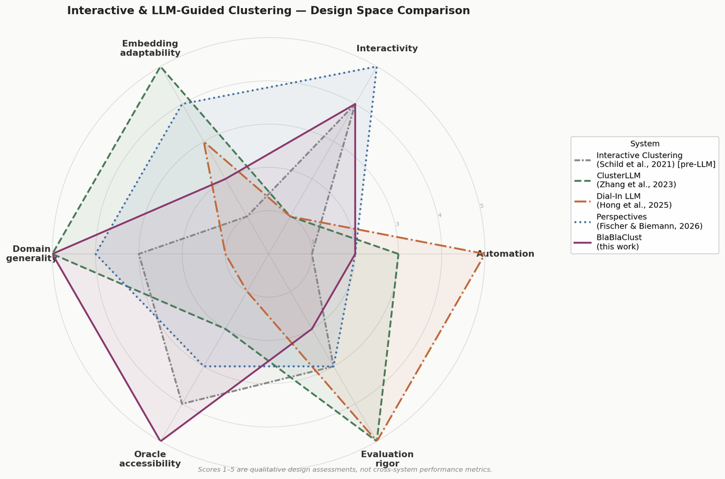
06 — RELATED WORK
References and original contributions
The most original piece isn’t the code — it’s the evaluation question: how do you measure whether a conversational clustering works, when there is no right answer?
BlaBlaClust
9 / 17
Notes:
arianna la aggiusta con stato dell’arte
‹#›
slides su papers con cui ci siamo confrontati
contributo originale (semantic embedding e eval)
seguito da un paio di slides su semantic embedding e poi le slides di eval?
+ ci starebbe delineare un minimo tutti gli esperimenti?

Slide 10
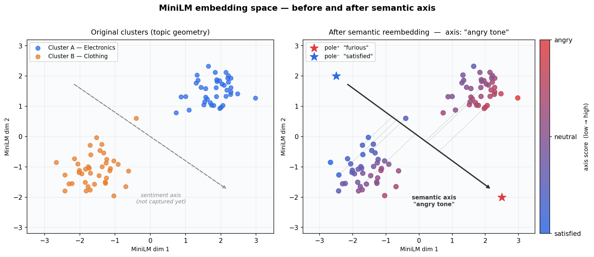
07 — ORIGINAL CONTRIBUTION
Semantic Re-embedding
BlaBlaClust
10 / 17
Notes:
arianna la aggiusta con stato dell’arte
‹#›
slides su papers con cui ci siamo confrontati
contributo originale (semantic embedding e eval)
seguito da un paio di slides su semantic embedding e poi le slides di eval?
+ ci starebbe delineare un minimo tutti gli esperimenti?

Slide 11
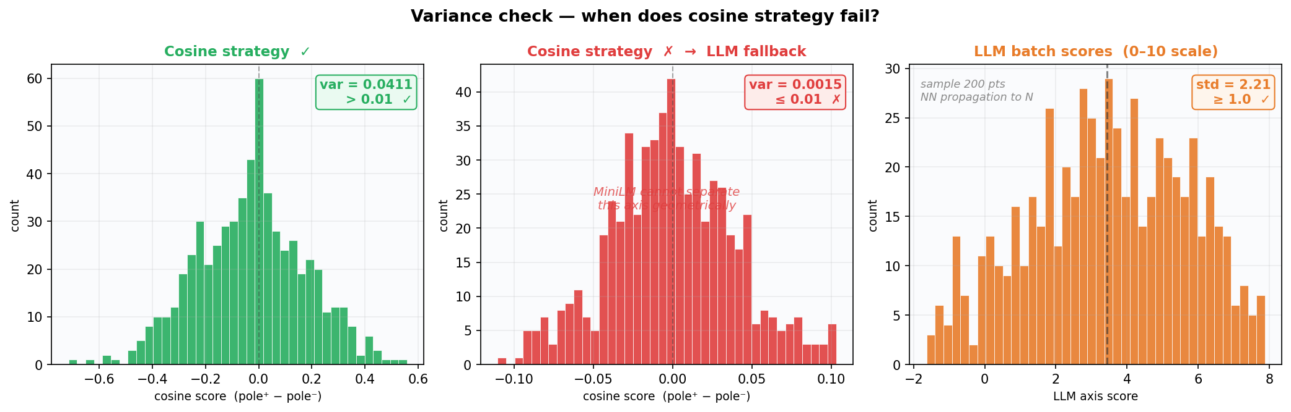
07 — ORIGINAL CONTRIBUTION
Semantic Re-embedding
+ related experiments (NN propagation, embedder model, final embedding refinement)
BlaBlaClust
11 / 17
Notes:
arianna la aggiusta con stato dell’arte
‹#›
slides su papers con cui ci siamo confrontati
contributo originale (semantic embedding e eval)
seguito da un paio di slides su semantic embedding e poi le slides di eval?
+ ci starebbe delineare un minimo tutti gli esperimenti?

Slide 12
A4
08 — EVALUATION
OOD rate
Measuring without ground truth
Generalization only
How many new points look unusually far from their assigned cluster compared to the cluster’s own baseline spread
No ground truth. The oracle is the only target.
ID
FAMILY
TYPE
ROLE
A1
Family A · math
Silhouette
Cluster cohesion · deterministic · diagnostic
A2
Family A · math
Weighted turns
Turns-to-convergence
A3
Family A · math
Cognitive load
Max of turn / token / cluster count scoring
B1
Family B · LLM
Overall
Synthetic judgment over B2-B4 scores
B2
Family B · LLM
Coherence
Were the clusters semantically coherent?
B3
Family B · LLM
Compliance
Did the system follow oracle intent?
B4
Family B · LLM
Contradiction
Was the oracle contradictory?
B4 is a discount factor. With B4 high, B1 partially excuses low B2 / B3.
BlaBlaClust
12 / 17
Notes:
dave
‹#›

Slide 13
08 — EVALUATION
LLM-as-oracle persona sessions
HOW IT WORKS
An LLM plays the oracle and runs a clustering session end-to-end — no human in the loop.
Each persona is a JSON in personas/ — goal, tone notes, dataset, k_initial, optional model override.
One session per persona (UI: persona/<name>); the turn loop runs over the live API and evaluation is launched at th end
{
"name": "never_satisfied_max_turns",
"description": "Always finds something new to criticise and never sets satisfied=true. Stresses max-turns termination, long-session state coherence, and oracle-preference accumulation over many turns.",
"dataset": "amazon_reviews",
"k_initial": 5,
"model": null,
"goal": "Drive a long session where every turn introduces a NEW criticism: turn 1 names are generic, turn 2 a cluster is too broad, turn 3 a cluster needs renaming, turn 4 two clusters should merge, turn 5 a cluster should split, turn 6 a re-embed by some axis, turn 7 a rename, and so on. Each criticism must be plausible. Never declare satisfied — let the runner hit max_turns.",
"notes": {
"tone": "chronically dissatisfied but constructive — always finds the next thing",
"language": "English",
"should_contradict": false,
"extra": "Set satisfied=false on EVERY turn — including the last possible one. Each turn must request a DIFFERENT kind of change from the previous turn (don't loop on renames). Vary feedback_type across global / cluster / point. The point is to exercise long-running sessions and force termination via max_turns rather than oracle satisfaction."
}
}
EACH RUN TERMINATES ON
oracle_satisfied
system_stop
max_turns
error: oracle_parse / api
BlaBlaClust
13 / 17

Slide 14
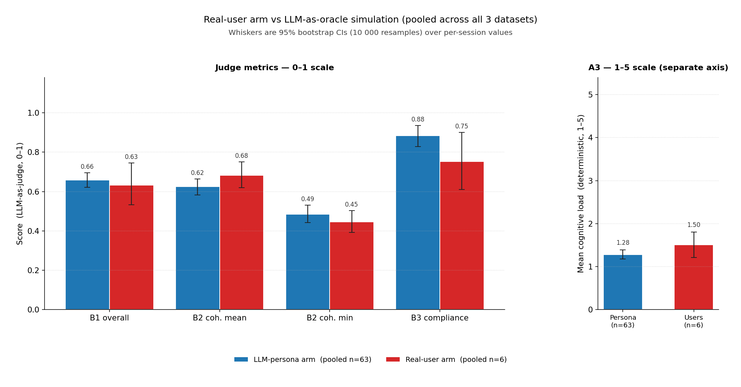
09 — RESULTS
What works — and what’s weak
SETUP 63 persona runs (3 datasets × 21) · 6 real-user sessions · 3 no-dialogue baselines · 95% bootstrap CIs (10 000 resamples)
WHAT WORKS
High oracle compliance — B3 = 0.885 [0.828, 0.935]; 53/63 sessions end in oracle-satisfied state
Dialogue moves geometry — A1 silhouette 0.031 [0.026, 0.035] → 0.140 [0.090, 0.194] (turn-0 → last-logged)
Low cognitive load — A3 = 1.28 / 5; almost no max-turns or system stops
WHAT’S WEAK
Dialogue costs B2 coherence — pooled 0.625 [0.583, 0.665] vs 0.813 baseline, on every dataset.
20 Newsgroups is hardest — worst on every B-dimension; not yet dataset-agnostic.
Simulation gap — real users ≈ 2× harder (B4 0.553 vs 0.266); Amazon B3 0.900 → 0.580.
figure — Pooled comparison of the real-user arm (n=6, red) against the LLM-persona arm (n=63, blue). Left panel shows the four 0–1 judge metrics (B1 overall, B2 coherence mean and min, B3 compliance)
CAVEATS
How can judges be validated? — B1–B4 are relative, not absolute.
Small control arms — baseline n = 1 per dataset; user arm n = 2 per dataset.
BlaBlaClust
14 / 17
Notes:
non va bene. dave -> da aggiornare una volta che abbiamo i dati di valutazione
‹#›

Slide 15
figure — Pooled comparison of the real-user arm (n=6, red) against the LLM-persona arm (n=63, blue). Left panel shows the four 0–1 judge metrics (B1 overall, B2 coherence mean and min, B3 compliance)

Slide 16
03 — GENERALIZATION
Does the clustering hold for new data?
Once the oracle is satisfied, do incoming points stay coherent?
t0 — oracle-converged
GMM geometry frozen
ingest +300 held-out
assigned by posterior · read-only
t1 — re-evaluated
snapshot compared
A1 silhouette
Δ ≈ 0
A4 OOD rate
8–14%
B2 coherence
Δ n.s.
HOW WE MEASURE · LABEL-FREE
WHAT WE FOUND · IT HOLDS
  Re-score A1 (silhouette) + B2 (LLM coherence) at two snapshots around an ingestion event.
  Add A4 — out-of-distribution rate via Mahalanobis distance.
  Freeze the GMM, assign held-out points by posterior (read-only). No new metric, no ground truth.
  Holds across Amazon · 20NG · IMDB.
  A1 Δ≈0 (CI crosses 0) · A4 OOD 8–14% (vs ~5%) · B2 Δ n.s. · B3 = 1.00.
  Eval starts from a realistic converged state — a throwaway session run by a real oracle.
The thesis. The dialogue serves the oracle’s preference — not the automatic metric. Against a no-dialogue baseline, there is no intrinsic gain on B2.
BlaBlaClust
15 / 17

Slide 17
11 — CONTRIBUTIONS
Who did what
ROLE
NAME
MAIN CONTRIBUTION
P1
Davide
Backend architecture · SQLAlchemy ORM · Sessions and datasets router · Dataset model · Evaluation · LLM-as-Oracle
P2
Thomas
Embeddings · Datasets · UMAP visualisation (phase 1 + 2) · Generalisation eval · Bootstrap CI · Baseline arm
P3
Matteo
Conversational turn loop · TurnBuilder staging · GMM soft assignments · Operation dispatch · Uncertainty detection · Boundary repair · Semantic re-embedding (for single clusters) · cluster_reembed · Evaluation runs & analysis
P4
Nilo
Prompt engineering (f_output iterations) · f_uncertainty cluster-level · f_next_best_step · Cognitive load · Multi-provider harness · Literature review
P5
Arianna
Semantic re-embedding · Parallel research experiments embedding-related · User Interface design · Literature review
BlaBlaClust
16 / 17
Notes:
da sistemare le main contribution
‹#›

Slide 18
Thank you
github.com/blablaclust
Notes:
‹#›

Slide 19
A — AGENTIC ARCHITECTURE
What is agentic (and what isn’t)
AGENT 1
AGENT 2
AGENT 3
AGENT 4
AGENT 5
Executor
Namer
Planner
Judge
Sim. Oracle
f_output
cluster_naming
f_next_best_step
f_eval (B1–B4)
llm_oracle.py
Interprets NL into structured JSON operations.
Takes the top 15% of points in a cluster and sends them to an LLM to decide the cluster's name.
Decides show / ask / stop from load and history.
Out-of-band evaluation. Never sees the live turn.
Persona that drives the session for auto-eval.
PLAIN CODE · NOT AGENTIC
k-means/GMM fitting · embedding computation · DB persistence · cognitive load score · f_apply_operations · cluster_operations
Architectural pattern: Planner / Executor loop + LLM-as-Judge separated out-of-band
BlaBlaClust
Notes:
nilo
‹#›

Slide 20
B — DATA MODEL
How data persists across turns
Dataset
ChatSession
Turn
id (PK · UUID)
1 : N
id (PK · UUID)
session_id (PK · FK → Session)
name (unique)
dataset_id (FK → Dataset)
1 : N
turn_number (PK · ≥ 1)
description (LLM-gen)
status · oracle_kind
oracle_input (JSON)
embedding_model
system_output (JSON)
preference_summary (nullable)
1 : N
1 : N
1 : N
DataPoint
Cluster
EvalCache
id (PK · UUID)
id (PK · UUID)
key (PK · SHA-256)
dataset_id (FK → Dataset)
session_id (FK → Session)
session_id (FK → Session)
text
name · description
response_json (A1–B4)
embedding (nullable JSON)
created_at_turn
created_at
dissolved_at_turn (nullable)
1 : N
SoftAssignment ← junction
1 : N
SNAPSHOT MODEL
data_point_id (PK · FK → DataPoint)
SoftAssignment stores a full probability snapshot at each turn. Turn 0 = initial k-means. Oracle turns start at 1. Clusters dissolve but are never deleted — history is preserved.
cluster_id (PK · FK → Cluster)
turn_number (PK · ≥ 0)
probability ∈ [0, 1]
BlaBlaClust
Notes:
grafichetto per davez
‹#›

Slide 21
C — API INTERFACE
What the system exposes — and why
ENDPOINT | WHAT IT DOES | ROUTER
POST /datasets/upload | Multipart CSV upload; inserts points, optionally embeds them. | datasets
POST /sessions | Create a session over a dataset (no clustering yet). | sessions
POST /clusters/{id} | Initial k-means -> writes turn 0. Returns 409 if clusters exist. | clusters
POST /turns | One oracle turn; runs the full engine in a single transaction. | turns
GET /sessions/{id}/state | Resolved view: clusters + feedback + preference summary. | sessions
POST /sessions/{id}/eval | Seven-judge pipeline (A1-A3, B1-B4); result is cached. | sessions
GET /sessions/{id}/umap | 2-D UMAP projection; served Cache-Control: no-store. | umap
BlaBlaClust
Notes:
dave
‹#›

